Slide 1
Gross Domestic Product Prediction using Machine Learning
PRESENTED BY
YASWANTH.CH (723921243011)
HEMANTH KUMAR.CH (723921243014)
MAHENDRA.G (723921243020)
ADARSH.V (723921243056)
PROJECT GUIDE
MR.BHASKHARAN NA
HEAD & ASSOCIATE PROFESSOR
DEPARTMENT OF AI & DS

Slide 2
ABSTRACT
GDP measures the market value of all goods and services produced within a country, serving as a key indicator of economic performance and national development.
It is measured using three approaches: (a) Expenditure Approach (total domestic spending), (b) Production Approach (value-added activities), and (c) Income Approach (total earnings from production).
This study aims to predict GDP using linear regression and random forest models to analyze economic trends over a specific period.
Accurate GDP forecasting helps governments in economic planning, policy formulation, and decision-making for sustainable growth.

Slide 3
LITERATURE REVIEW
Author Name | Paper Title | Domain and Problem Statement | Methods
Long Gang | GDP Prediction by Support Vector Machine Trained with Genetic Algorithm | Focuses on economic forecasting using machine learning to address accuracy challenges. | Utilizes Support Vector Machines (SVM) with Genetic Algorithms.
Jaehyun Yoon | Forecasting of Real GDP Growth Using Machine Learning Models: Gradient Boosting and Random Forest Approach | Explores GDP forecasting by improving model robustness and feature selection. | Employs Gradient Boosting and Random Forest techniques.
John Roush, Keith Siopes, Gongzhu Hu | Predicting Gross Domestic Product Using Autoregressive Models | Examines GDP prediction through time-series economic data with emphasis on temporal dynamics. | Applies Autoregressive Models for statistical analysis and forecasting.
Luca Coscieme, Lars F. Mortensen, et al. | Going Beyond Gross Domestic Product as an Indicator to Bring Coherence to the Sustainable Development Goals | Challenges traditional GDP metrics, advocating for alignment with Sustainable Development Goals (SDGs). | Proposes a holistic framework linking GDP metrics to SDGs.

Slide 4
EXISTING SYSTEM
GDP is a key economic indicator used to assess a country's economic health by measuring the monetary value of all goods and services produced within its borders.
Limitations: Traditional GDP analysis relies on limited data modeling techniques, making it difficult to handle large datasets and reducing prediction accuracy.
Proposed System: This study aims to improve GDP prediction using Linear Regression and Random Forest models to analyze economic trends more effectively.
Advantages: Machine learning models allow for better analysis of past economic patterns and more precise forecasting of future economic changes.
Impact: Accurate GDP predictions help governments formulate economic policies, set development goals, and make informed financial decisions.

Slide 5
PROPOSED SYSTEM
The proposed system aims to predict GDP using machine learning techniques such as Linear Regression and Random Forest. The prediction model uses historical data and economic indicators to forecast GDP trends, aiding governments and policymakers in economic planning.

Slide 6
ADVANTAGE
Enhanced accuracy in GDP prediction.
Supports better economic decision-making.
Provides insights into factors affecting GDP.
Enables automated analysis and visualization of GDP trends.
Offers a scalable and efficient solution.

Slide 7
ALGORITHM
Data Collection: Collect GDP-related data from sources like Kaggle.
Preprocessing: Handle missing values, remove outliers using IQR method.
Feature Selection: Identify key economic indicators influencing GDP.
Model Training: Implement Linear Regression and Random Forest models.
Evaluation: Assess model accuracy using error metrics.
Prediction & Visualization: Generate forecasts and display graphical representations.

Slide 8
SYSTEM SPECIFICATION
HARDWARE REQUIREMENT
Processor : Intel Core i3 or above
RAM : 512 MB minimum
Hard Disk : 40 GB
SOFTWARE REQUIREMENT
OS : Windows Family
Programming Language : Python
Libraries : Pandas, Scikit-learn, Matplotlib

Slide 9
MODULE
Adds dataset for analysis.
Oversees data preprocessing and classification.
Generates predictions and graphs for insights.

Slide 10
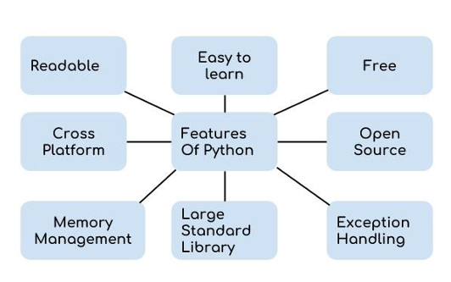
FEATURES OF PYTHON

Slide 11
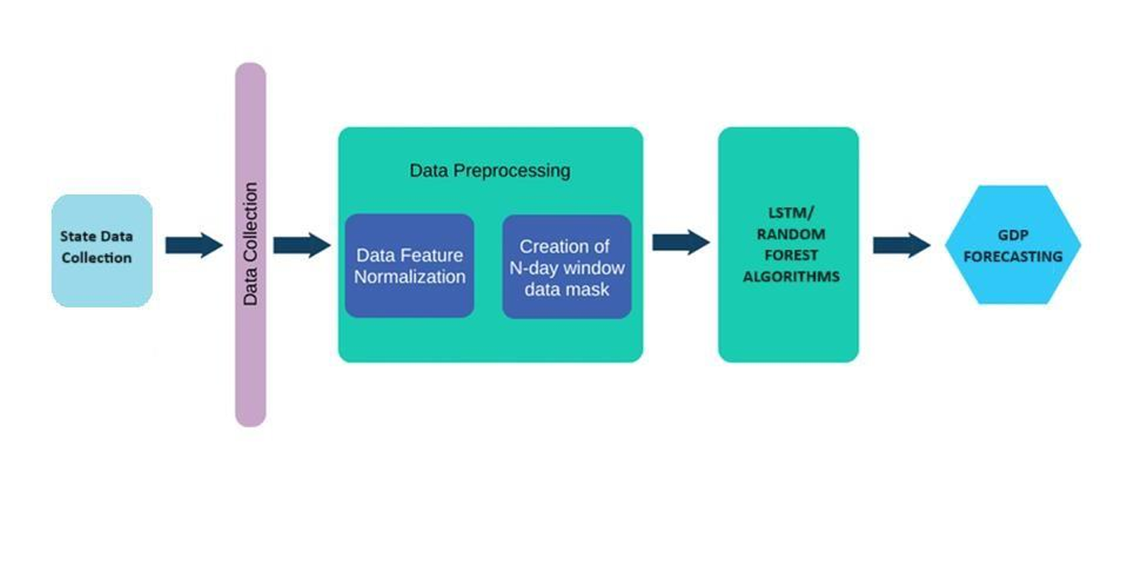
ARCHITECTURE DIAGRAM

Slide 12
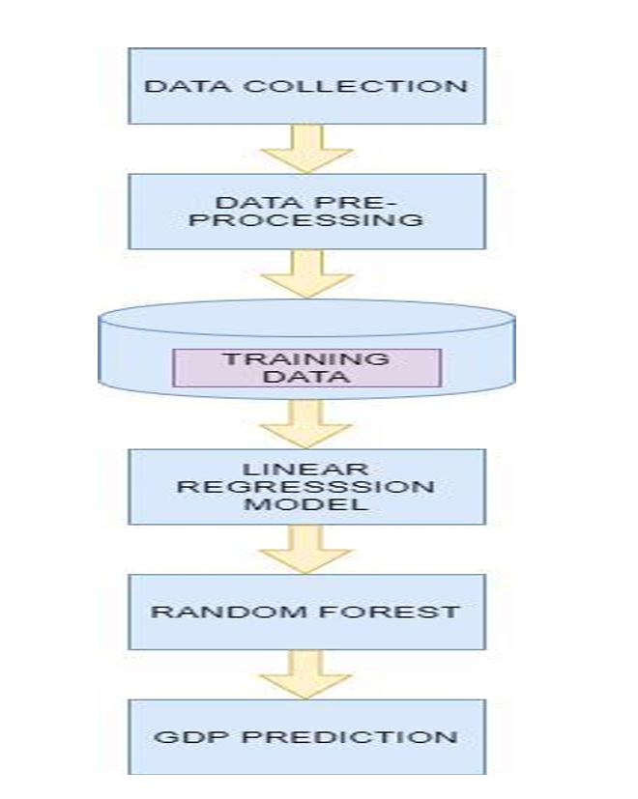
FLOW DIAGRAM

Slide 13
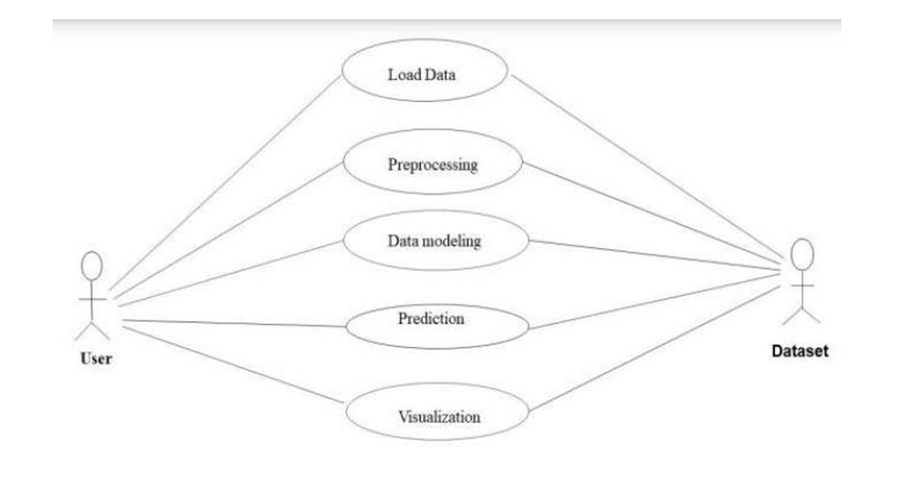
USE CASE DIAGRAM

Slide 14
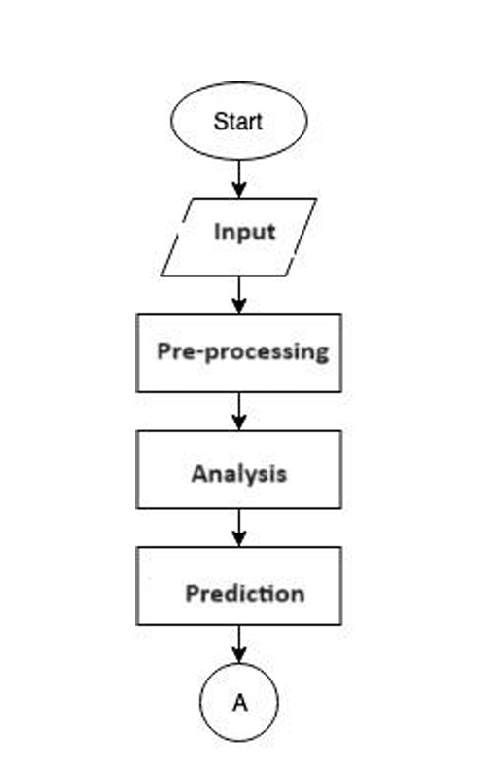
ACTIVITY DIAGRAM

Slide 15
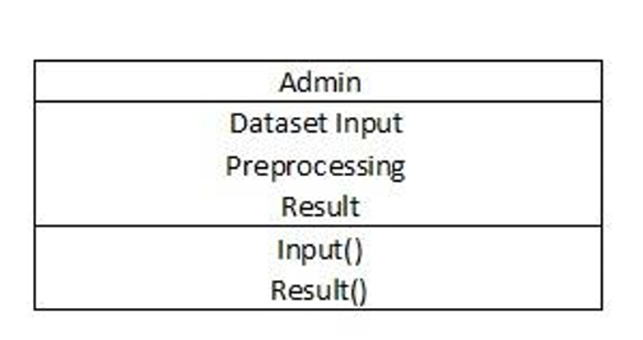
CLASS DIAGRAM

Slide 16
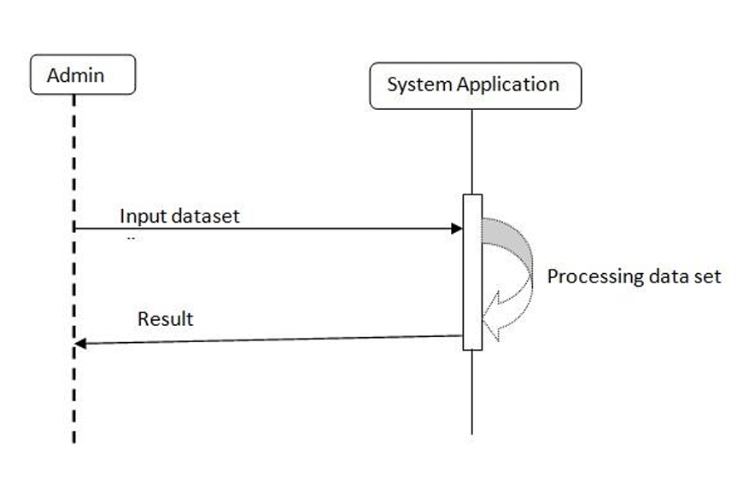
SEQUENCE DIAGRAM

Slide 17
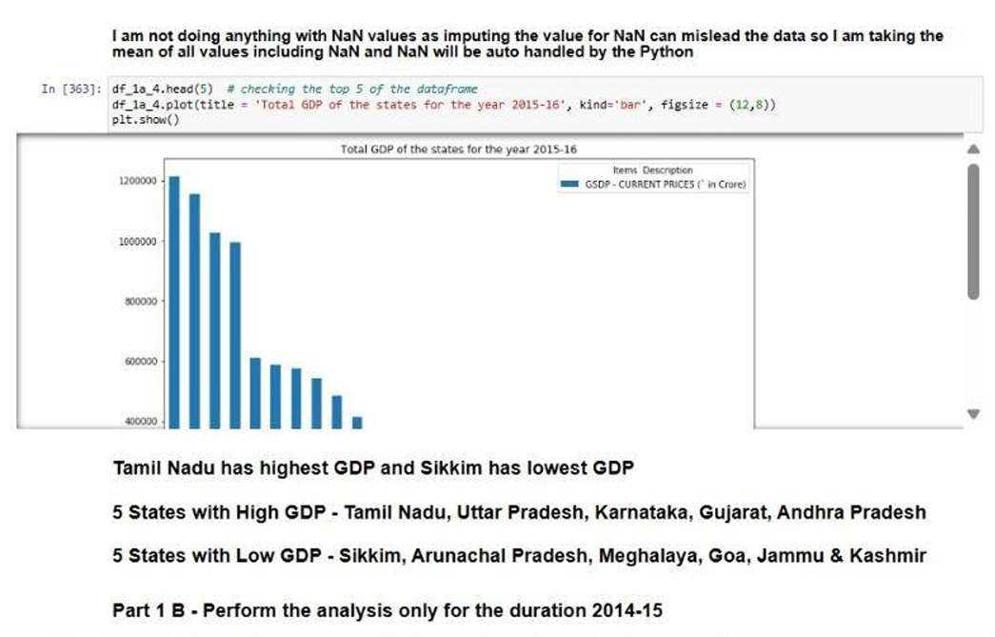
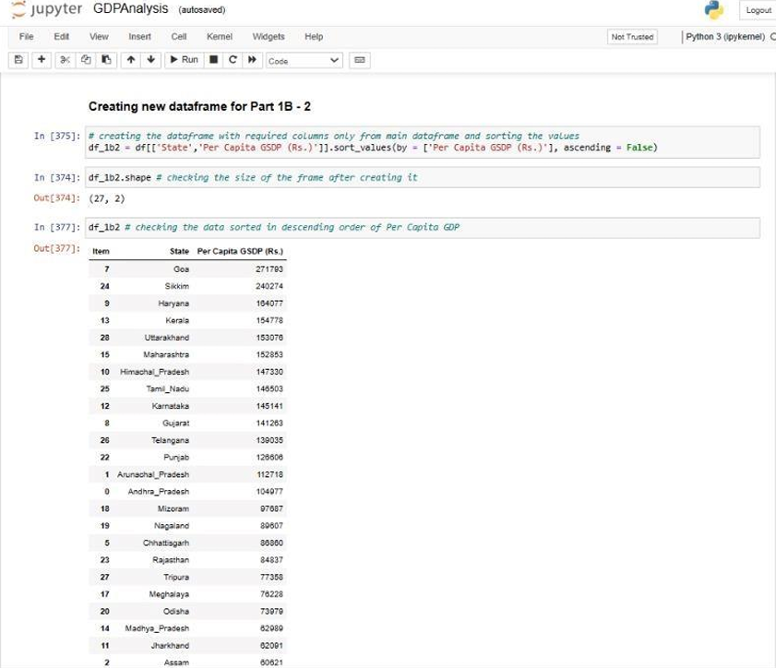
RESULT AND DISCUSSION
The study found that Random Forest achieved 86% accuracy in GDP prediction.

Slide 18
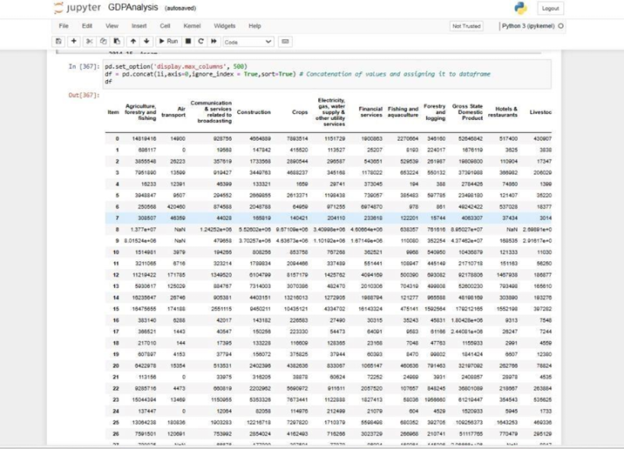
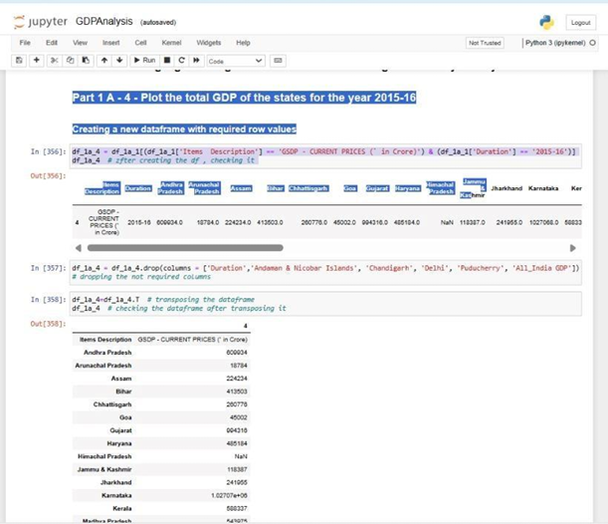
Random Forest outperformed Linear Regression in forecasting GDP trends.

Slide 19
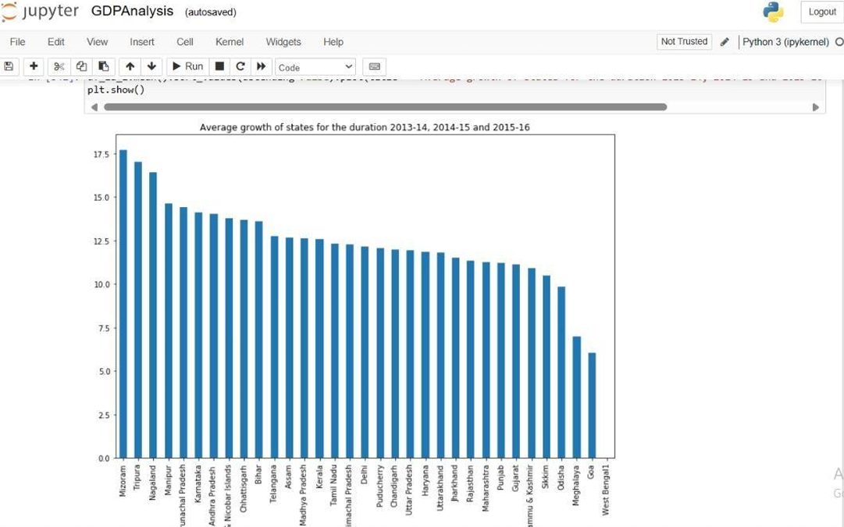
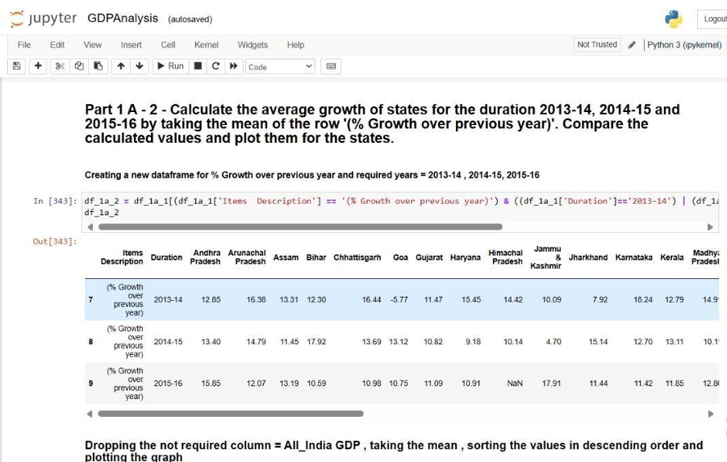
The model helps policymakers set economic goals and strategies.

Slide 20
Conclusion
The system collects and preprocesses GDP-related data, ensuring data quality and relevance.
Machine learning models, including Linear Regression and Random Forest, are trained to analyze economic indicators.
The trained models generate accurate GDP predictions, supporting economic forecasting and policy-making.
The results are visualized in an intuitive manner, aiding stakeholders in understanding economic trends and making informed decisions.

Slide 21
REFERENCES
Jaehyun Yoon - "Forecasting of Real GDP Growth Using Machine Learning Models: Gradient Boosting and Random Forest Approach," Springer Science+Business Media LLC, part of Springer Nature, 2020.
Gary L. Shelley and Frederick H. Wallace - "Inflation, Money, and Real GDP in Mexico: A Causality Analysis," Applied Economics Letters, vol. 11, no. 4, pp. 223–225, 2004.
Martin Schneider and Martin Spitzer - "Forecasting Austrian GDP Using the Generalized Dynamic Factor Model," September 17, 2004.
Luca Coscieme et al. - "Going Beyond Gross Domestic Product as an Indicator to Bring Coherence to the Sustainable Development Goals," Journal of Cleaner Production, vol. 248, 2019.

